Slide 1
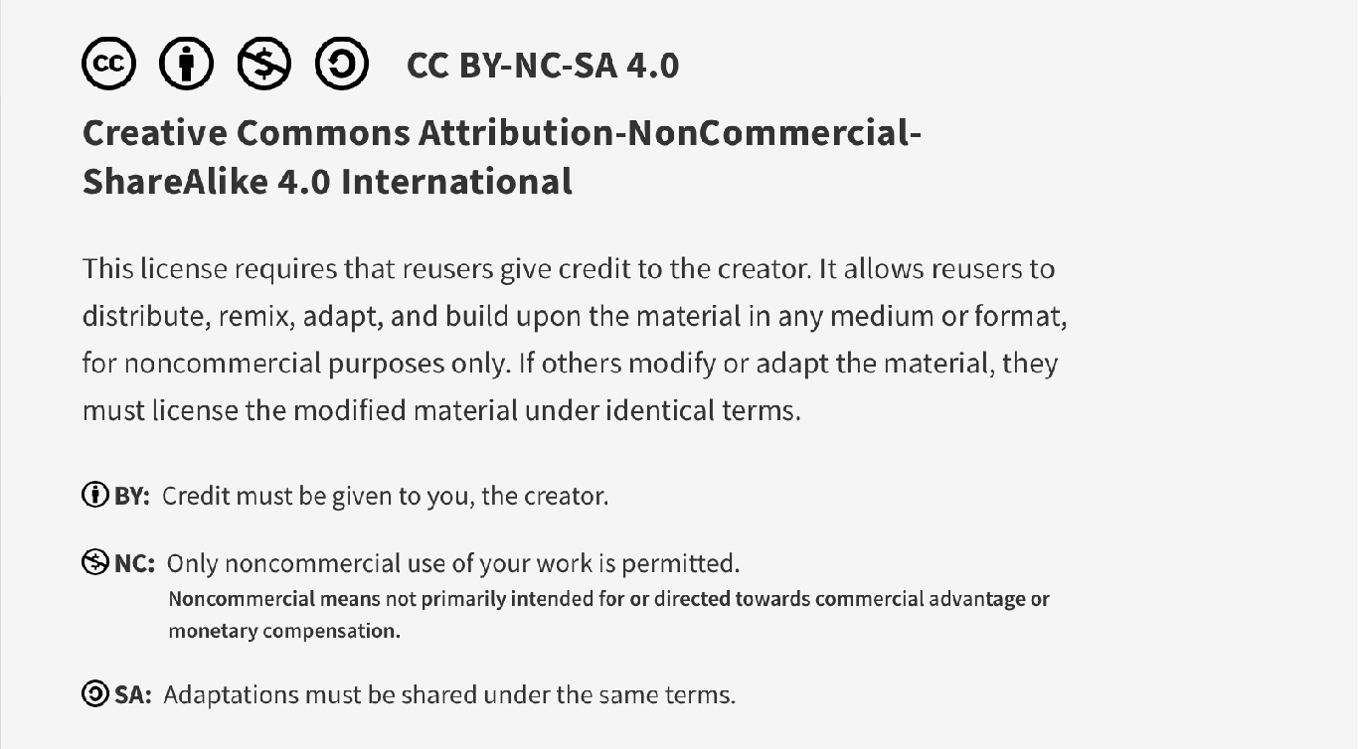
This work is licensed under CC BY-NC-SA 4.0. To view a copy of this license, visit: https://creativecommons.org/licenses/by-nc-sa/4.0/

Slide 2
Intro to Quality Improvement 2 QI Project Creation Pre-session material
Lucie Filteau, MD, FRCPC
PGY 2-4 AHD
QPS Lecture series

Slide 3
Why Choose to Create/Lead the Change?
“If you’re not at the table you’re on the menu…”
Better to take ownership of an issue
Creating the change internally is better than having it imposed by an “outsider”
Imposed top down, outsider interventions
often lack sufficient insight into the problem and its root causes
often lack insight into the most impactful solutions
don’t result in front line buy-in
are often, as a result of one or all three of the above, ineffective

Slide 4
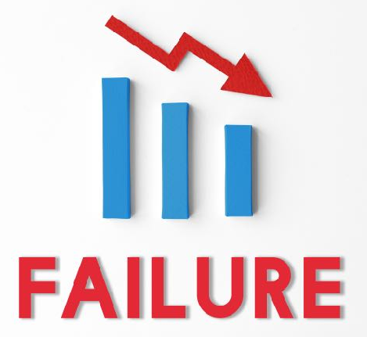
Thoughts on Change
Change is HARD for individuals, organizations
Common sense QI principles are often ignored
Most attempts to change fail
Many initiatives that initially succeed fail to sustain
Don’t wing it: you need a solid plan and to avoid the pitfalls…
Make sure you’re passionate about the issue, as this will help to keep you going during the tough bits...
(All images without reference from freepik.com)

Slide 5
This Session
Pre-session material
Choosing the right project
Project exploration, considering scope, feasibility
Developing a project plan
Selecting stakeholders, cause analysis, intervention plan(s), measurement
Consider sustainability of the change
Developing a communication/marketing plan
REB tips
Carrying out the plan
Publishing guidance
Interactive session
We’ll discuss specific considerations for a hypothetical project

Slide 6

Assessing the Problem/Potential Project

Slide 7
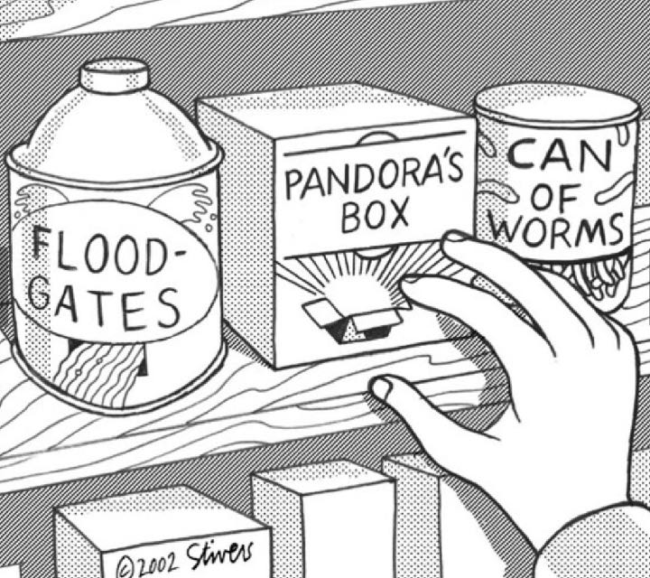
How bad is it?
Preliminary exploration can involve:
Walkabout audits
Observing behaviours
Lounge chat with colleagues
Discussion with stakeholders
Preliminary chart review
Literature review
Consulting with patients
Reviewing survey results
Etc.
Mark Stivers, 2002

Slide 8
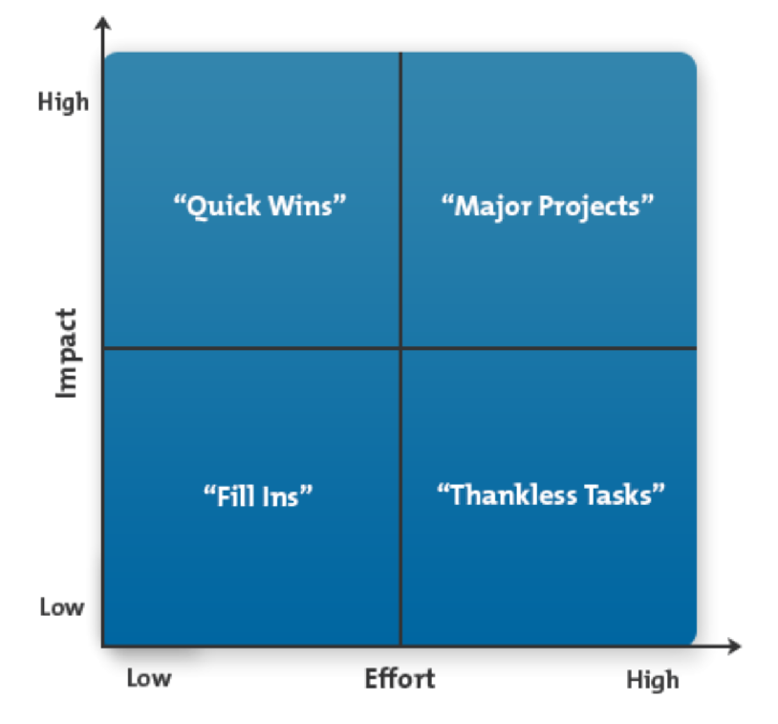
Choosing the Right Project
Consider amount of effort required and degree of impact
Prioritization Matrix
Best to aim for lower effort, higher impact projects = QUICK WINS
AVOID high effort, low impact initiatives!
Table taken from TOH QI Tools

Slide 9
Beware of Scope Creep!
With the “big picture” goals in mind, people often bite off more than they can chew in a single project with a specific timeline and limited resources
Complex problems have several contributing factors and it’s best to focus on a single factor (WELL) within a project than try to tackle multiple causes all at once (LESS EFFECTIVELY)

Slide 10
Scope Creep
e.g. “I want to reduce the surgical site infection (SSI) rate at my hospital”
vs.
“I want to improve the intraoperative antibiotic redosing compliance rates in long (>3.5hr) spine surgeries (which are associated with a higher SSI rates) within the next 12 months.”
Remember to keep your aim statements focused and SMART
Specific, Measurable, Attainable, Relevant, Time-framed

Slide 11
Consider Project Feasibility
Embarking on a project with too many major obstacles is very likely to result in failure
Examples of major project obstacles
Many don’t agree that there’s a problem
The change represents a significant cultural shift
Problem causes are unknown and/or exploration of causes poses a threat to people
Direct opposition (or lack of support) to project (from front line and/or managers)
Many stakeholders directly benefit from status quo
Many changes required in several complex/interlinked systems to effect the desired change
Considerable funding is required (which is not already budgeted/available)
Significant specialist support is required
A considerable amount of restructuring and retraining/skill development is needed
The required change is outside of your realm of influence (e.g. dept under someone else’s leadership)

Slide 12
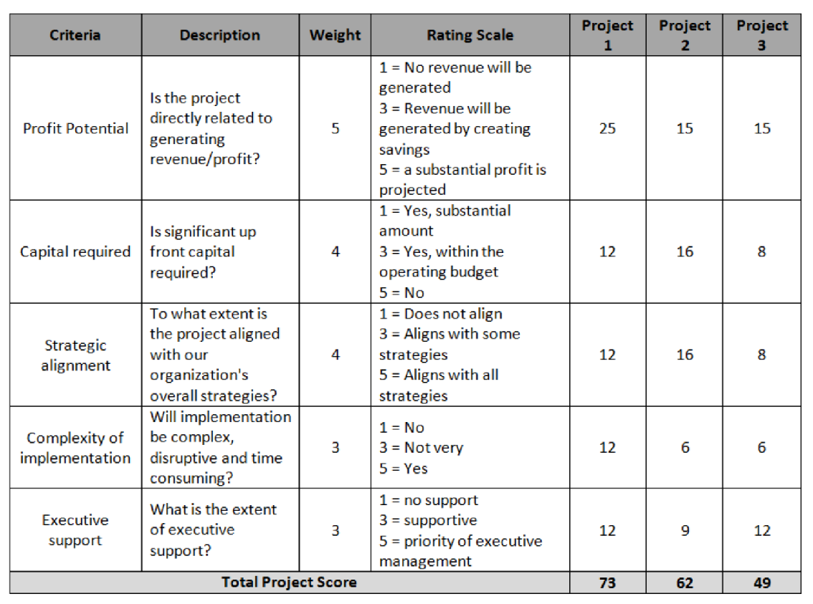
Project Feasibility Scoring
Consider quantifying feasibility for a more objective assessment of potential projects
See simplified scoring template to the right (avoid Project # 3!)
A more thorough feasibility assessment is provided in the pre-session materials
Table taken from TOH QI Tools

Slide 13
QI Project Plan – Questions to Tackle
1. Who would you involve in your project (stakeholders)?
2. What do you think is contributing to this problem?
3. Which aspect of this issue would you propose to tackle?
(What/how would you change to produce improvement?)
4. Is the planned change sustainable?
5. What would you measure/track?
6. How would you manage/market the change?

Slide 14

1. Creating a Team

Slide 15
Picking Your Team Members
Multidisciplinary teams are best
Who has insight into problem?
Who has insight into the solution?
Who can reduce obstacles?
Which influencers will champion the cause?
Who will be affected by the change?
These are your STAKEHOLDERS
(NB: This group often evolves over time )

Slide 16

2. Identify the Root Causes

Slide 17
Root Cause Analysis Tools
There are many RCA tools available*
5 Why’s
Fishbone/Ishikawa diagram
Process mapping
Pareto analysis
Constellation diagram
Failure Mode and Effects Analysis (FMEA)
Best tools used depend on the nature of the problem being studied
Can use more than one tool for some problems
BEST analyses involve multidisciplinary teams of stakeholders for diverse inputs/perspectives!
*Slides 18-21 are illustrative examples of RCA’s for the benefit of the PGY-2’s, who weren’t at the Spring 2021 Systems Thinking session

Slide 18
5 Why’s -a series of iterative WHY questions to get at deeper underlying causes
Caught Speeding
Why?
Late for Work
Why?
Woke Up Late
Why?
Risk of Recurrence
Alarm Clock Didn’t Work
Why?
Improvement Inertia
Battery Died
Why?
Didn’t Replace

Slide 19
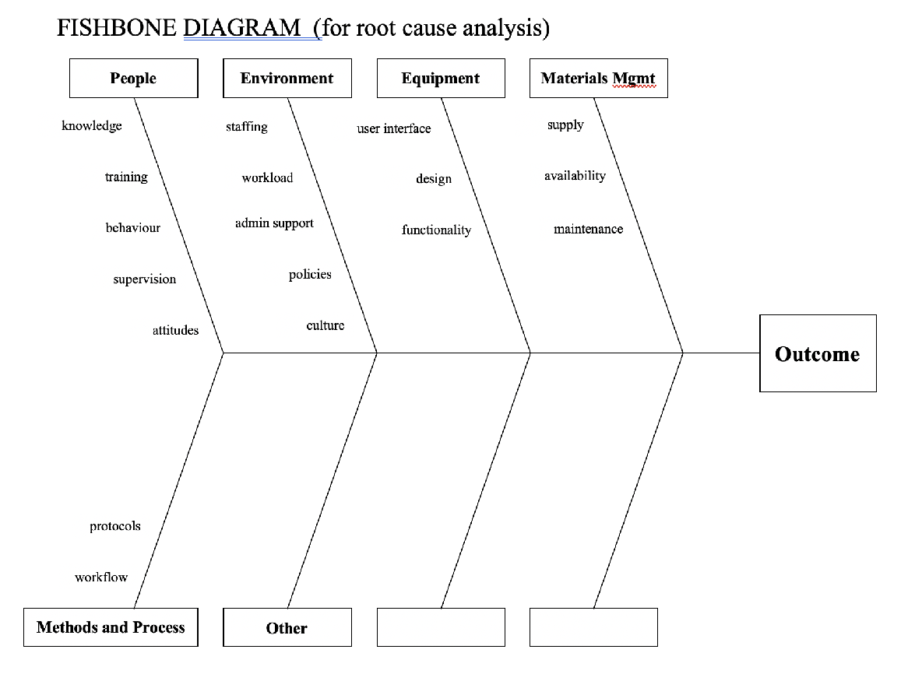
Fishbone/Ishikawa Diagram

Slide 20
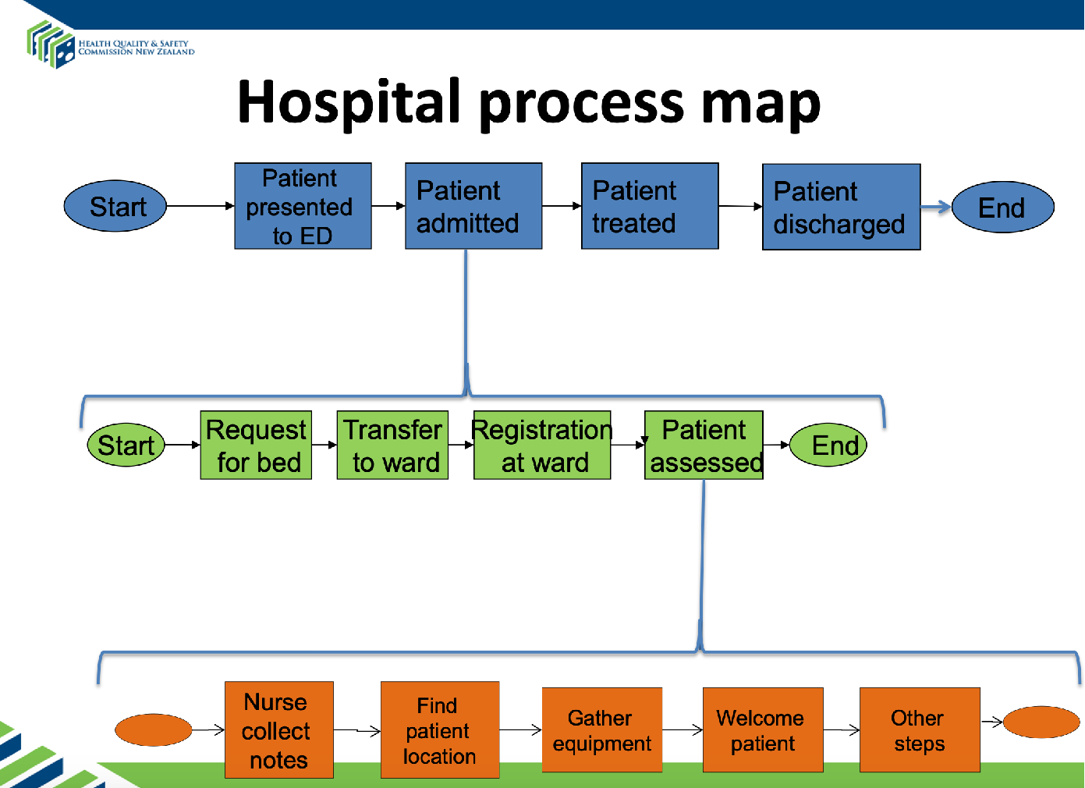
Process Map: Healthcare Example
Each step on higher level sequence can be broken down into component steps
Add players involved
Identify pain points (delays, inefficiencies, redundancies)
https://www.hqsc.govt.nz/assets/Medication-Safety/collaborative/PR/LS1/004-process-mapping-Prem-Kumar.pdf

Slide 21
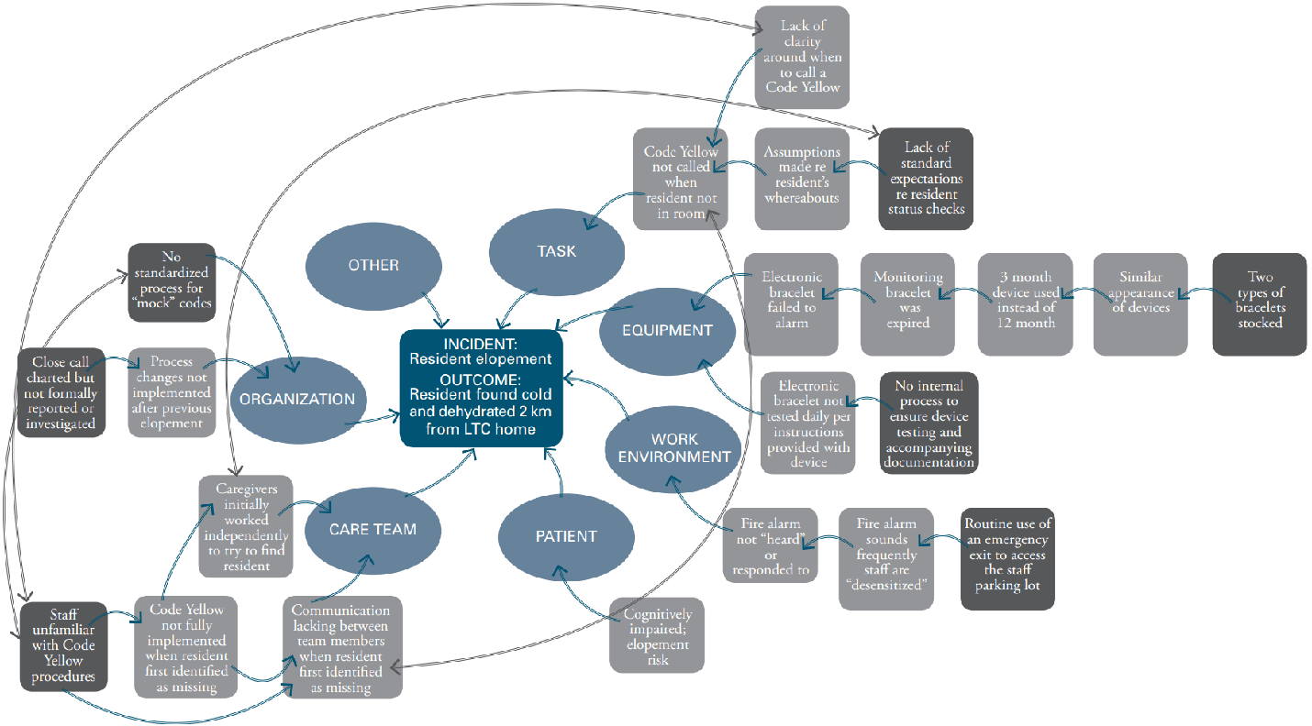
Constellation Diagram
INCIDENT:
Patient elopement
OUTCOME:
Patient found cold and dehydrated 2 km from LTC home
Adapted from: CPSI’s Canadian Incident Analysis Framework

Slide 22
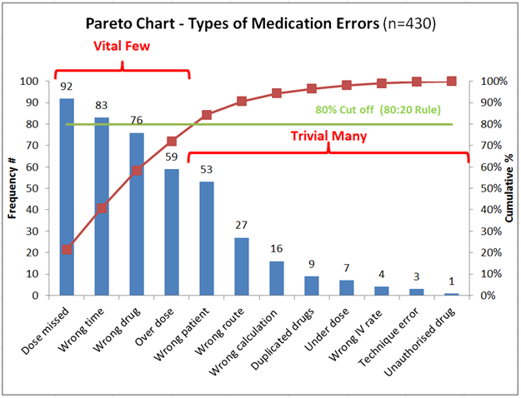
Pareto Chart
To track the most important causes
Bars = frequency or cost of a factor
Maroon line = cumulative total

Slide 23
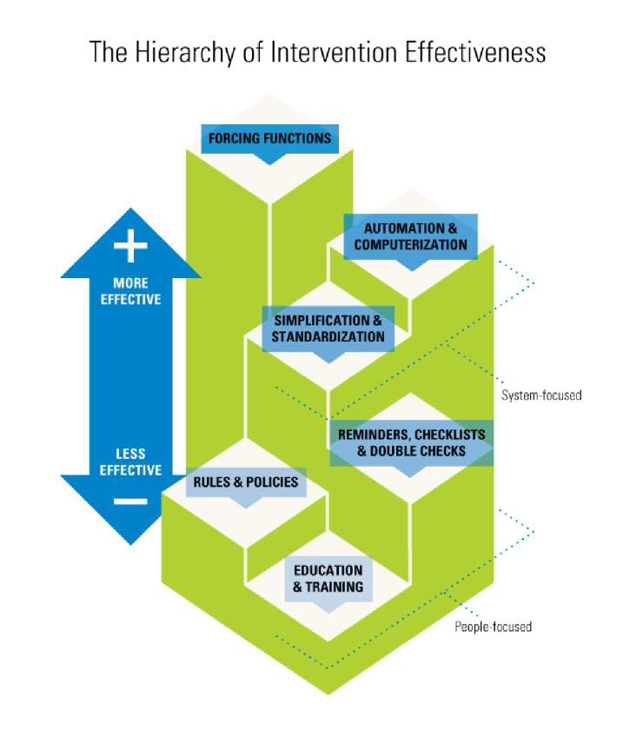
3. Hierarchy of Intervention Effectiveness
Forcing functions
- O2/N2O/Air hoses
Automation
- EPIC allergy warnings
Standardization
- Care maps
Checklists
- Surgical safety checklist
Policies
- Hospital PPE usage rules
Education/training
Diagram created by Cassie McDaniel

Slide 24
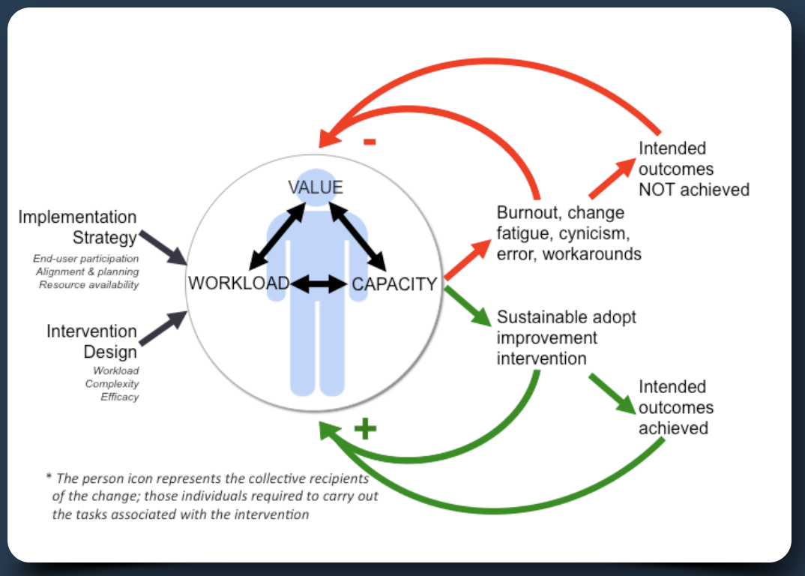
4. Consider Sustainability of Change
Red path: when initiative increases workload and has perceived low value
Green path: when workload (to adopt change) is low and perceived value is high
“Workload”: cognitive, physical and time
Dr. Chris Hayes http://www.highlyadoptableqi.com/tools

Slide 25
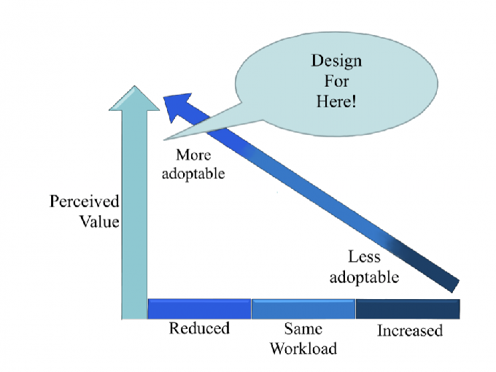
Strategies to Maximize Sustainability
Choose interventions with demonstrated degree of belief
Recommend making the associated workload a balance measure (i.e. measure the objective and subjective impact of the change on workload)
Work smarter, not harder:
Always simplify the intervention to minimize workload
Consider other changes to offset the increased load
Try to remove any/all “wasted” work
http://www.highlyadoptableqi.com/about

Slide 26
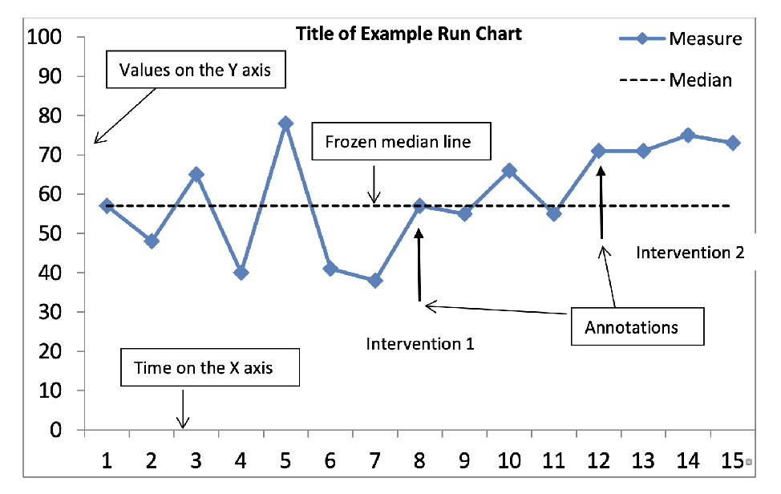
5. Measurement?
What to measure?
(covered in last session):
Outcome measures
Process measures
Balancing measures
How to display data in QI? Run Charts are common.
Data plotted repeatedly over time to first demonstrate baseline data (and its degree of variability) and then assess for performance changes
Determine median line from baseline (pre-intervention) data
Need 15 successive points to be able to apply “run chart statistical rules”

Slide 27
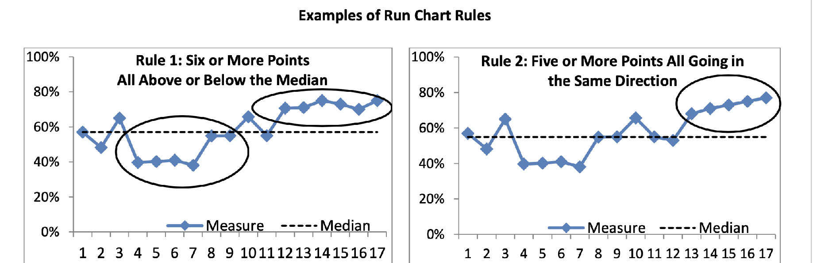
Run Chart Interpretation
Rules 1 and 2 demonstrate a pattern that indicates that “something” has happened to change data/performance that was not due to random chance (NB: may or may not be the actual intervention!)

Slide 28

6. Implementing/Marketing Change Wisely

Slide 29

Things to Consider
Timing
avoid mid-late Dec, July!
Competing demands
other major initiatives, global crises
department climate
staff burnout
Plan for maximum buy in
effective messaging is key
who will communicate plan?
who will publicly support it?

Slide 30

Effective Messaging
“Do this because I said so” X
“Do this because it’s our new hospital policy” X
“Do this to improve a very real quality/safety issue” ✓
Maximum impact: solid data + evoke emotion ✓
data to convince audience of the problem and potential for proposed solution
emotion helps to create impetus for change (e.g. excitement, inspiration, empathy, fear, spirit of competition)

Slide 31

Effective Messengers, Supporters
Selling change is a marketing exercise
Who are your departmental influencers?
They aren’t necessarily the formal leaders…
Consider
authenticity, integrity, credibility, respect
knowledge
passion
communication skills
NB: Influencers can significantly help OR hinder your project so engage/involve them early

Slide 32

Consider Methods of Info Dissemination
Multimodal messaging is key
rounds
staff meetings
emails
newsletter
ELM’s
posters
lounge chats
electronic discussion platforms
social media platforms
any other ideas?

Slide 33
Before You Begin: Research Ethics Board!
Lines between research and QI often blurred, so best to still submit project protocol to REB prior to the start
If plan to publish your work, you need to do this
REB supplies a handy screening checklist to determine if REB review and approval are required
Pure QI projects:
Typically exempt from full REB review
REB board provides letter saying review is waived
Very fast process! (@ 2 wks vs 90 days for full review)

Slide 34
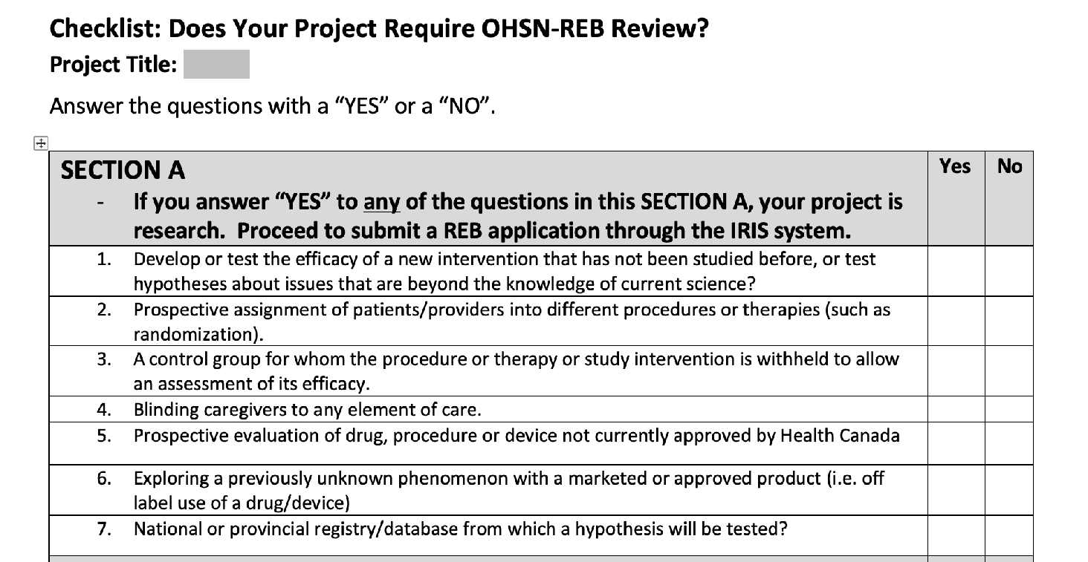
REB QI Checklist: Section A
If answer no to all questions:
Pure QI, REB review waived
If answer yes to ANY question:
Full REB review required
http://www.ohri.ca/ohsn-reb/qi.htm

Slide 35
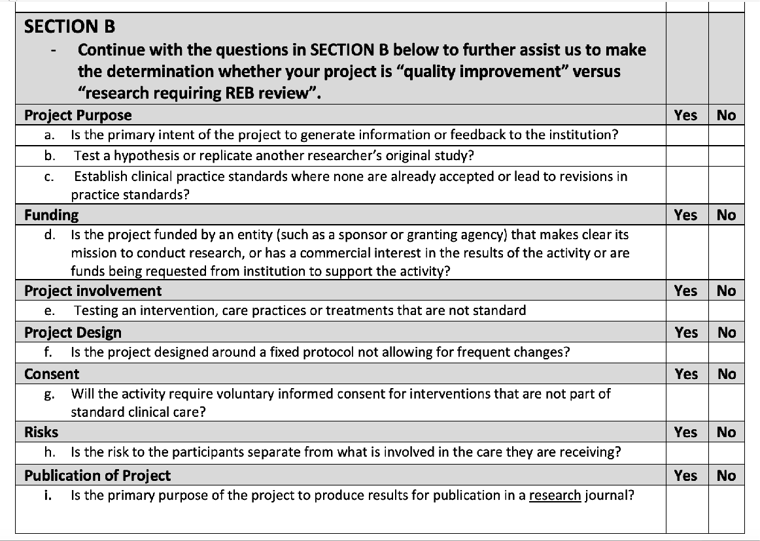
REB QI Checklist: Section B
If answer no to most questions = QI
Discuss with REB
If answer yes to most questions = Research
Full REB review required

Slide 36
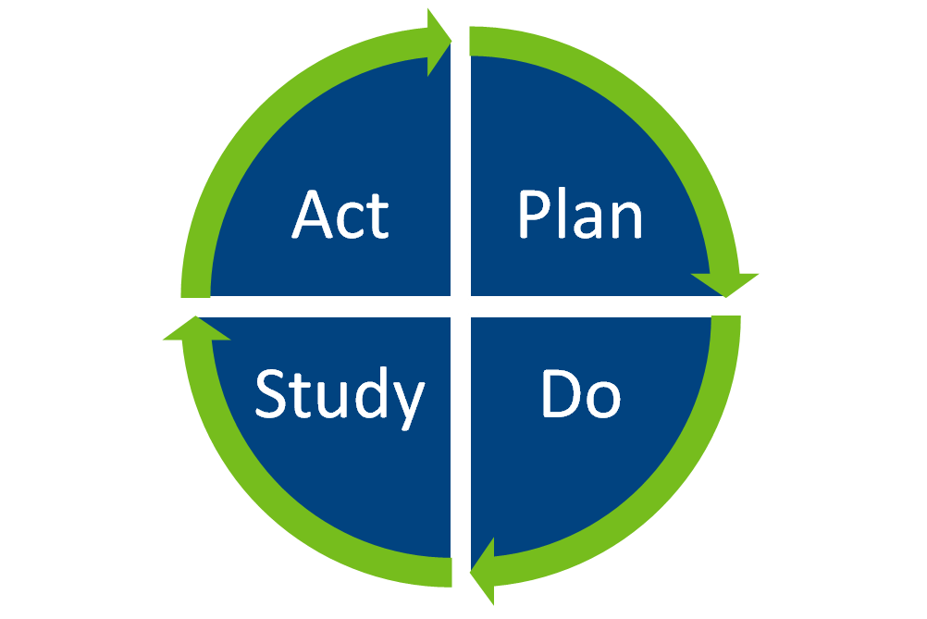
During the Project
Test project on a smaller scale (one limited area/group), work out the kinks and plan to expand later
Continuously reassess how things are going
Be prepared to adapt the intervention to the local context
Be prepared to pause the project (e.g. COVID)
Continue to consult with front line throughout
Change things up if it’s not working (or not sustaining)
You may need to go back to the root cause analysis...

Slide 37

To Publish: QI Specific Reporting Standards
https://qualitysafety.bmj.com/content/qhc/25/12/986.full.pdf

Slide 38
Key Strategies to Maximize Success
Understand the problem FULLY before planning change
Study root causes, consult, involve the front line
Consider locus of control
It’s easier to change what’s within your realm of influence!
Maximize project support by:
Picking a REAL shared pain point that resonates
Being aligned with organization’s priorities for leadership buy-in
Engaging stakeholders early and often
Making the new workflow easy to adopt
Identifying champions, influencers, detractors – address early
Starting with low hanging fruit and sharing early wins with the team

Slide 39
“Never doubt that a small group of thoughtful, committed citizens can change the world; indeed, it’s the only thing that ever has.”
Margaret Mead

Slide 40
This work is licensed under CC BY-NC-SA 4.0. To view a copy of this license, visit: https://creativecommons.org/licenses/by-nc-sa/4.0/

